Slide 1
US POPULATION FORECASTING-TIME SERIES

Slide 2
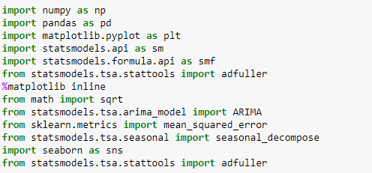
IMPORTING REQUIRED LIBRARIES

Slide 3
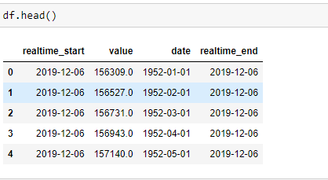
READING THE DATA

Slide 4
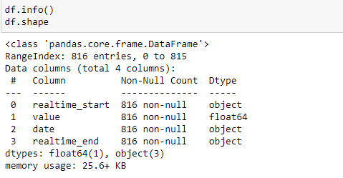

DIMENSIONS OF THE DATA
Converting date dtype into datetime format

Slide 5
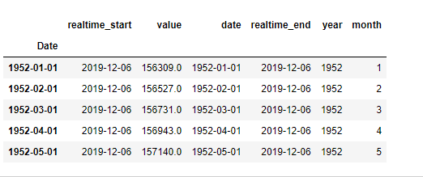
INDEX
Making date as the index

Slide 6
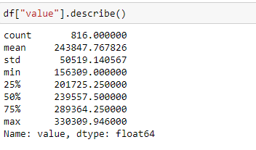
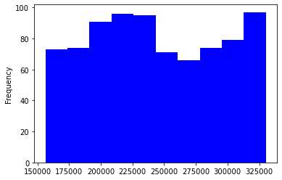
STATISTICAL DESCRIPTION & ANALYZING TARGET VARIABLE
Average population is 243847.76, Minimum population is of 156309 and maximum population is of 330309.94

Slide 7
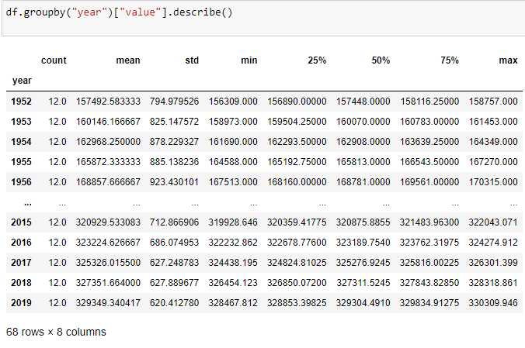
EDA
YEAR WISE DESCRIPTION OF TARGET VARIABLE

Slide 8
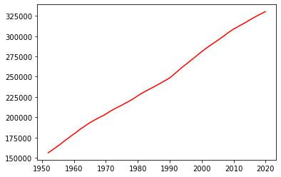
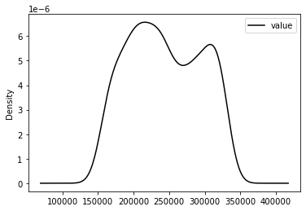
EDA
LINE & density PLOT BETWEEN DATE AND TARGET VARIABLE
Population counts are increasing year by year

Slide 9
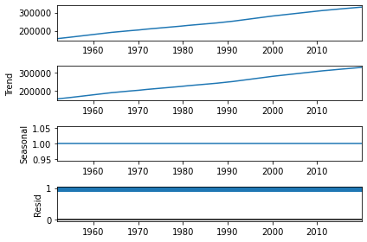
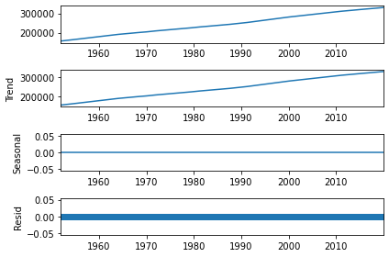
EDA
DECOMPOSING THE TIME SERIES
MULTIPLICATIVE
ADDITIVE
From the above decomposition we can observe that there is no trend and seasonality in the data

Slide 10
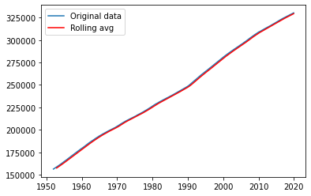
MOVING AVERAGE
dfMA = df.rolling(window=12).mean()
plt.plot(df,label='Original data')
plt.plot(dfMA,color='red',label='Rolling avg')
plt.legend(loc='best')
plt.show()

Slide 11
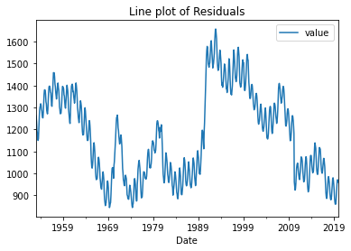
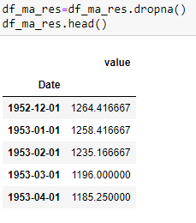
RESIDUALS
df_ma_res=df_ma_res.dropna()
df_ma_res.head()
#Lineplot
df_ma_res.plot()
plt.title('Line plot of Residuals')

Slide 12
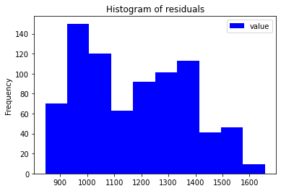
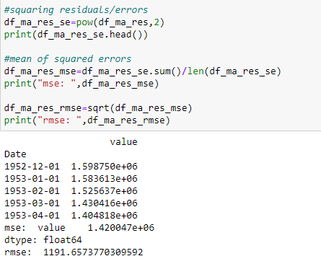
EDA
HISTOGRAM OF RESIDUALS

Slide 13
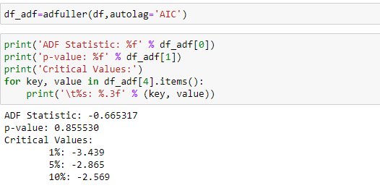
DICKEY FULLER TEST
p-value: 0.85 ie > 0.05, Null Hypothesis is accepted, so, Data is not stationary
H0 data is not stationary. Let us do AUTO ARIMA

Slide 14
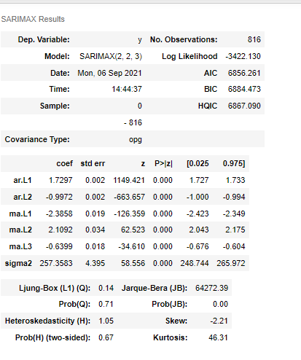
AUTO ARIMA SUMMARY

Slide 15
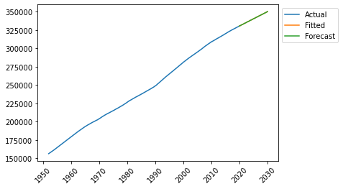
FINAL FORECASTING PLOT
This model clearly fits very well in the timeseries and gets the prediction for the next 10 years from 2020-01-01.
df_pred = df_mod.predict(n_periods=121)
df_pred = pd.DataFrame(df_pred,
index=pd.date_range(start='2020-01-01',end='2030-01-01', freq='MS'))

Slide 16
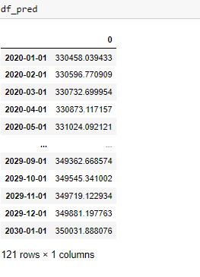
POPULATION FORECAST FOR 10 YEARS

Slide 17
THANK YOU

